Slide 1
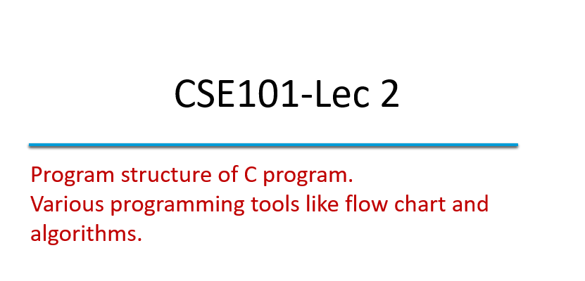

Slide 2
Algorithm
Algorithm is defined as “ the finite set of steps, which provide a chain of action for solving a problem”
It is step by step solution to given problem.
Well organized, pre-arranged and defined textual computational module

Slide 3
Characteristics of good Algorithm
Correctness - terminates on ALL inputs (even invalid inputs!) and outputs the correct answer.
Simplicity - each step of the algorithm performs one logical step in solving the problem.
Precision - each step of the algorithm is unambiguous in meaning.
Comprehensibility - the algorithm is easy to read and understand.
Abstraction - presents the solution steps precisely and concisely without referring to low-level (program code) details.
Efficient - Gives results rapidly based on the problem size; does not waste any space or time.
Easy to Implement - relatively easy to translate into a programming language.

Slide 4
Steps to create an Algorithm
1. Identify the Inputs
What data do I need?
How will I get the data?
In what format will the data be?
2. Identify the Outputs
What outputs do I need to return to the user?
What format should the outputs take?

Slide 5
Steps to create an Algorithm
3. Identify the Processes
How can I manipulate data to produce meaningful results?
Data vs. Information
4. Break the Solution to steps
By breaking the solution to the steps we can easily understand the logic of program

Slide 6

Example of Algorithm
To establish a telephone communication
Step 1: Dial a phone number
Step 2: Phone rings at the called party
Step 3: Caller waits for the response
Step 4: Called party picks up the phone
Step 5: Conversation begins between them
Step 6: After the conversation, both disconnect the call

Slide 7
Algorithm: Add 2 Numbers
Problem: To add two numbers.
Step1. Start.
Step2. Take the two numbers.
Step3. Add them.
Step4. Print the result.
Step5. Stop.

Slide 8
Flow Chart
Flow Chart is pictorial representation of an algorithm.
Whatever we have done in algorithm we can represent it in picture.
It is easy to understand.
Shows the flow of the instruction

Slide 9
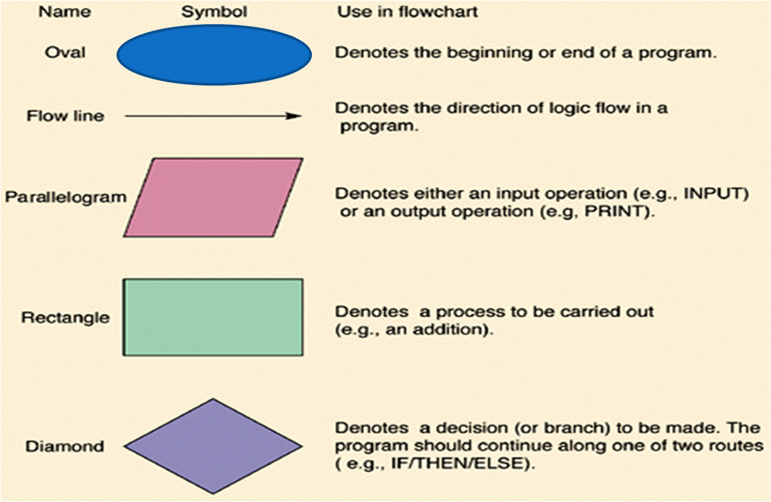
Flow Chart Symbols

Slide 10

Flow Chart: Add 2 Numbers
START
Quick yak:
Ask students to draw a flow chart for going to a movie…
TAKE TWO NUMBERS A and B
FIND SUM=A+B
PRINT SUM
STOP

Slide 11
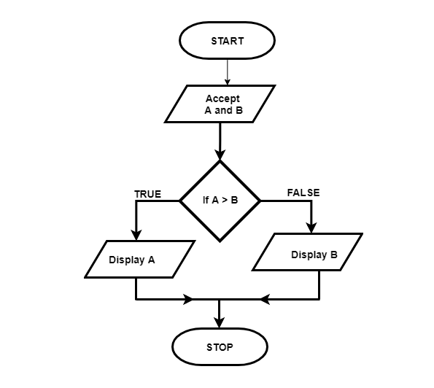
Flow Chart: Greater than two Numbers

Slide 12
Pseudocode
pseudocode statements that appear to have been written in a computer programming language but do not necessarily follow any syntax rules of any specific language.
The purpose of using pseudocode is that it is easier for people to understand than conventional programming language code, and that it is an efficient and environment-independent description of the key principles of an algorithm.

Slide 13
Example of Pseudocode
start input myNumber set myAnswer = myNumber * 2 output myAnswer Stop

Slide 14
MCQ
Q1 The symbol denotes _______
I/O
Flow
Terminal
Decision

Slide 15
MCQ
Q2 In computer science, algorithm refers to a pictorial representation of a flowchart. a) True b) False

Slide 16
Explanation
A simple C program consists of
Comments (optional)
//
/*….*/
Including header files
#include<header file name>
Functions
main function as special function
Other user defined functions (optional)
Let’s discuss these in detail..

Slide 17
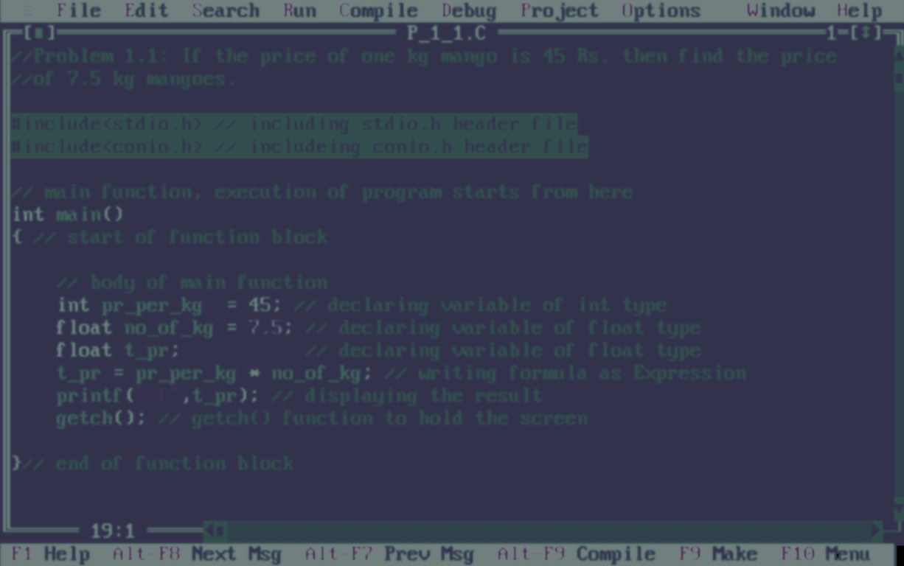
Comments
Two forward slashes ‘ // ’ (double forward slashes), are used to write single line comment
The next combination ‘ /*……..*/ ’ (forward slash with asterisk) is used for commenting multiple lines
These comments are not being executed by compiler
* comment can appear anywhere in a program where a white space can appear

Slide 18
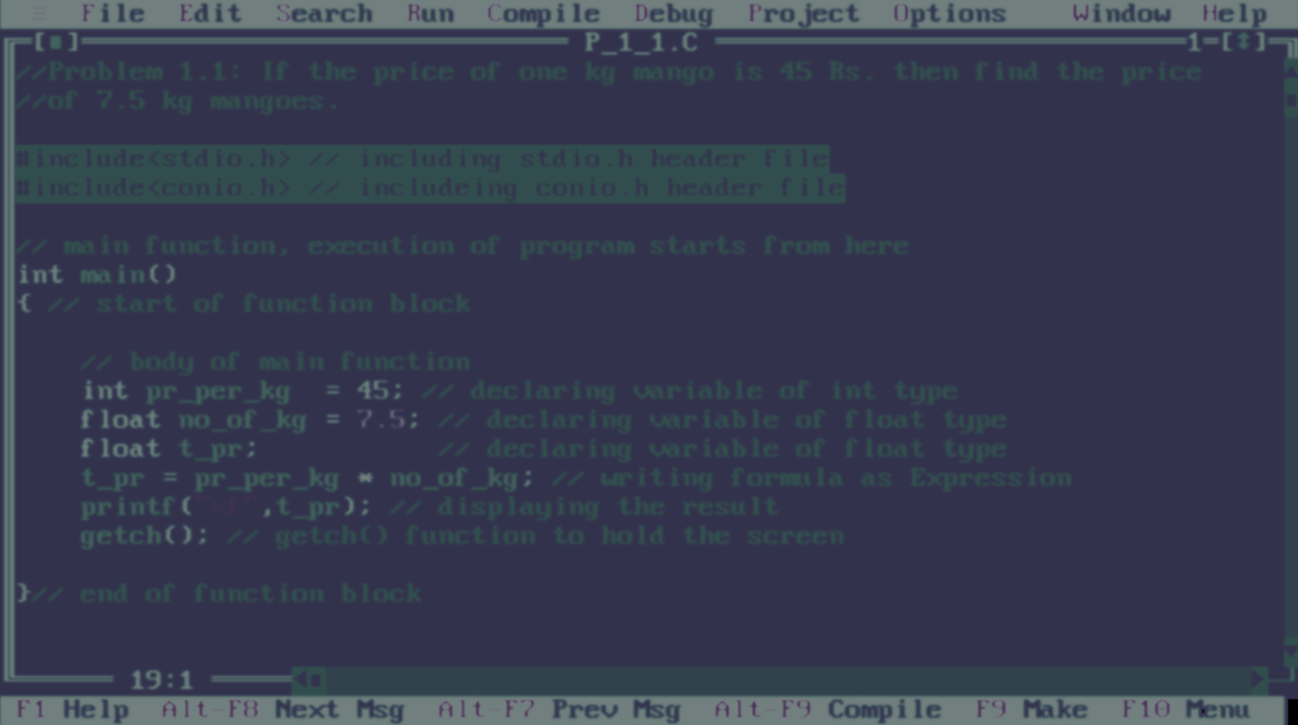

Header files
The next two lines are command for including header files
These two lines must be included in every C program
stdio.h: standard input output header file for functions printf(),scanf(),... and so on
conio.h: console input output header file for functions getch()…. and so on
Here ‘ # ‘ is called preprocessor directive

Slide 19
Header files
C code example
Program
//Sample program
#include<stdio.h> //header file for printf()
#include<conio.h> //header file for getch()
int main()
{
//stdio.h is providing printf() function
printf(“Car is under process”);
//conio.h is providing getch() function
getch();
}
Output:
Car is under process

Slide 20
Next Class: Components of C Identifier and Keywords Data Type

